Slide 1
An Improved Current Loop Bandwidth and Axis Decoupling for High Speed Electrical Drives Using Multisampled Control

Slide 2
Table of Contents
02
04
IMPLEMENTATION
DSP algorithm
Timings & averaging
FUTURE PLAN
INTRODUCTION
Goal & motivation
Limitations
CURRENT PROGRESS
Simulink
HIL
Analytics
01
03

Slide 3
Goal & motivation for the research
01
Higher bandwidth with same or smaller overshoot
02
Better dq decoupling @ higher speeds
03
large signal disturbance rejection
04
Multisampling offers delay reduction

Slide 4
Multisampling - potentials
TBD by Ivan (slide for illustration of delay reduction)

Slide 5
Multisampling - limitations
TBD by Ivan

Slide 6
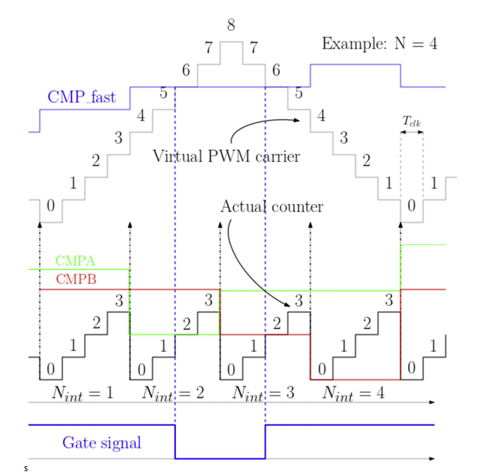
Multisampling DSP algorithm
Example: UR=4
No missed edges due to vertical crossings
Only one ePWM module that runs on control frequency (UR*fpwm)
The maximum and minimum values of the virtual carrier, for the following control period are used to distinct cases with horizontal and vertical intersections with the virtual carrier
A slight modification was required, after experimentally verifying the algorithm: cross_margin added in order to ensure active register loading before the compare action

Slide 7
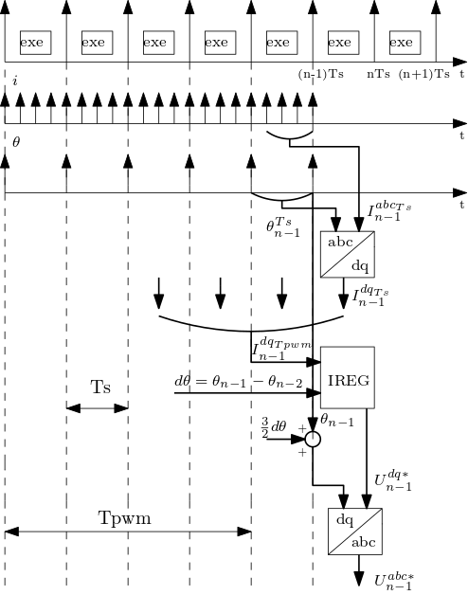
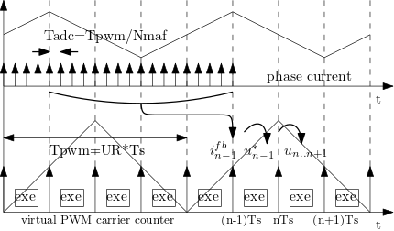
Timings & averaging
Feedback averaging
Current: Moving Average Filter (MAF) over one switching period
Angle: averaging on regulation period
fpwm=10kHz, Nmaf=16, UR≤8

Slide 8
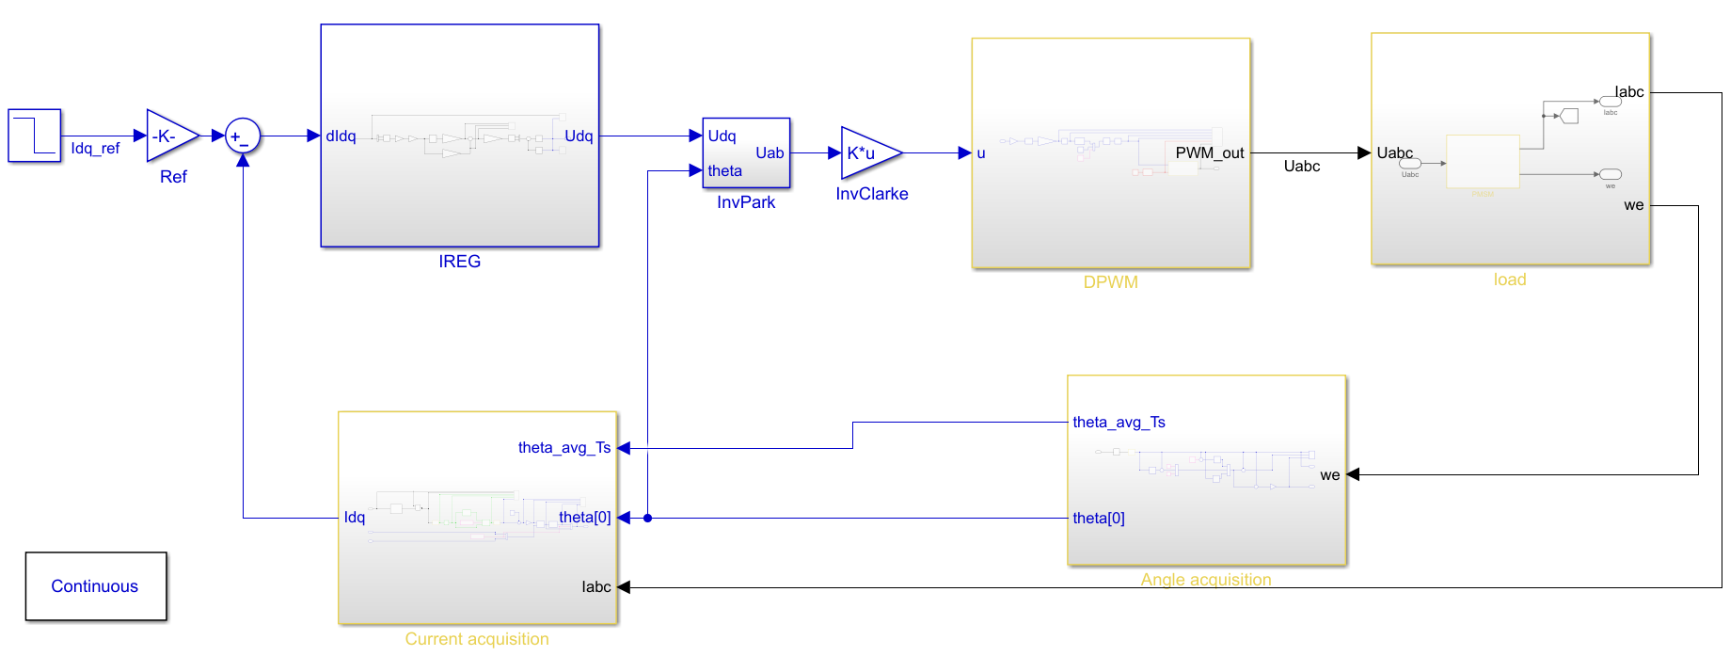
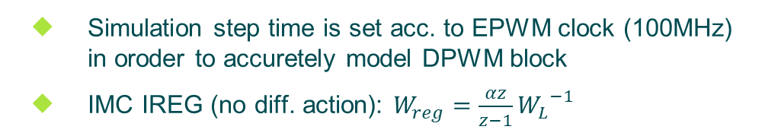
Current progress – Simulink (1)
Simulation step time is set acc. to EPWM clock (100MHz) in oroder to accuretely model DPWM block
IMC IREG (no diff. action): $W_{reg}=\frac{αz}{z−1}{W_{L}}^{−1}$
BLDC parameters (vukosavic2016.pdf):
Rs=0.47Ω, Ls=3.4mH, kemf=0.687 Vpeak/(rad/s), Inom=7.3A

Slide 9
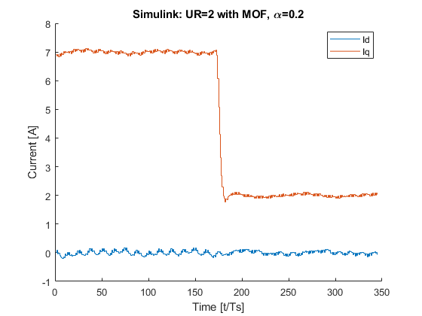
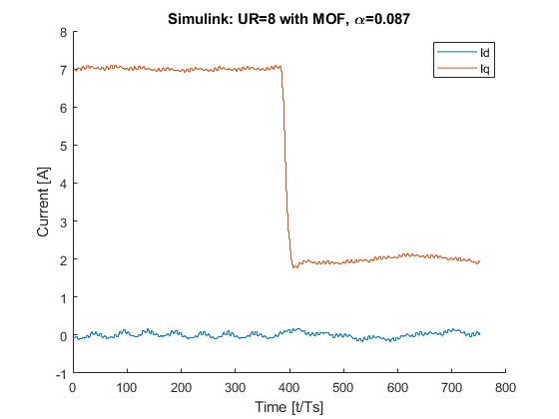
Current progress – Simulink (2)
DQ step response
UR=8 VS. UR=2 (both with MAF 16x)
For UR=8 α is set to obtain same overshoot as for UR=2 with alpha=0.2
UR | 2 | 8
MAF | yes | yes
α | 0.2 | 0.087
OS | 4.7% | 5%
fbw(-3dB) | 0.09/Ts | 0.28/Ts
Simulink: UR=2 with MAF, α=0.2
Simulink: UR=8 with MAF, α=0.087

Slide 10
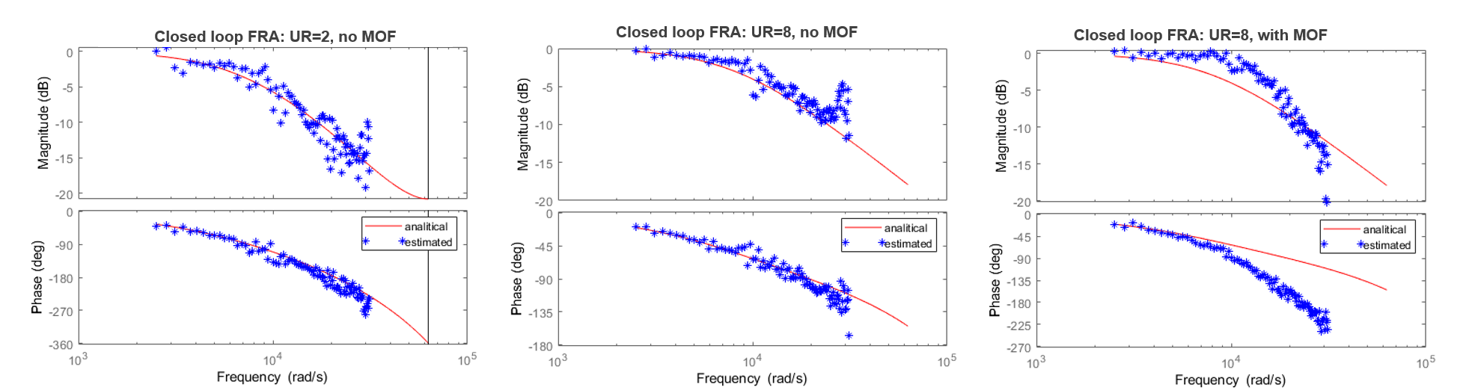
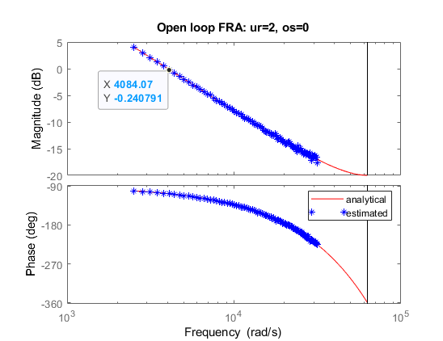
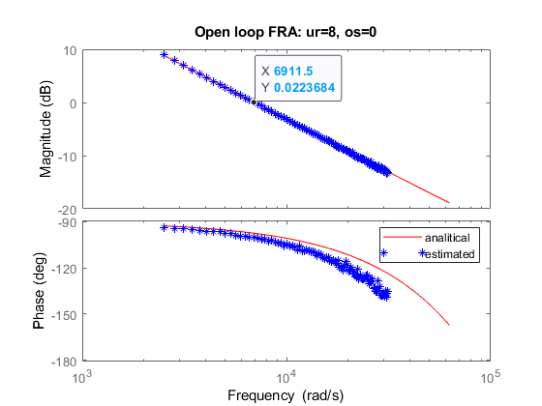
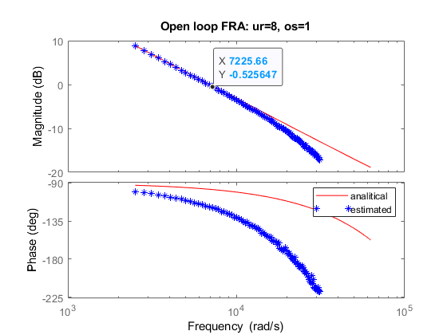
Current progress – Simulink (3)
Frequency Rsponse Analysis (FRA)
Simulation without dead-time
Comparison with analytical transfer function for UR=2 without MAF
Closed loop FRA: UR=2, no MAF
Closed loop FRA: UR=8, no MAF
Closed loop FRA: UR=8, with MAF
Open loop FRA: UR=2, no MAF
Open loop FRA: UR=8, no MAF
Open loop FRA: UR=8, with MAF

Slide 11
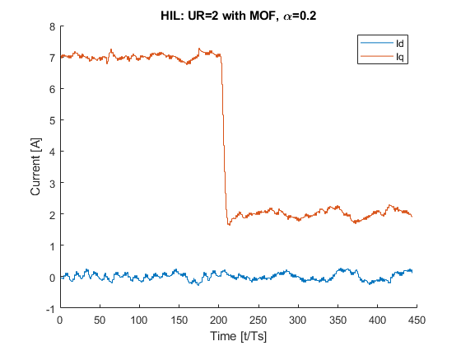
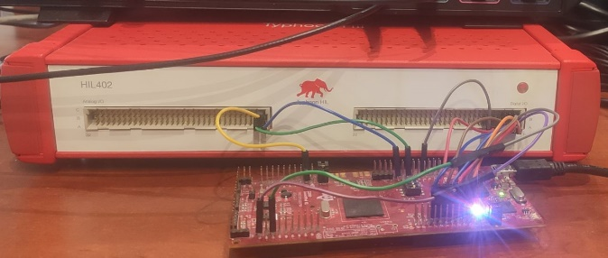
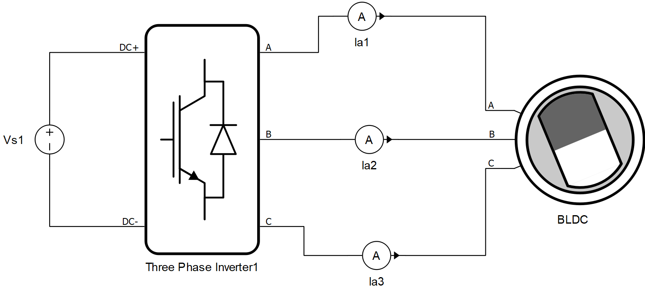
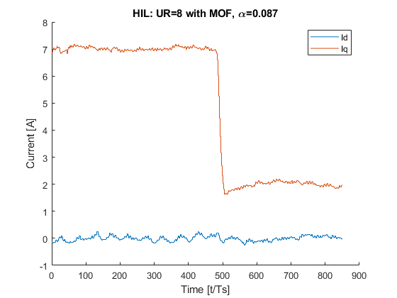
Current progress - HIL
HIL: UR=2 with MAF, α=0.2
Typhoon HIL 402 & F28379D launch pad
Similar parameter settings as in Simulink
UR | 2 | 8
MAF | yes | yes
α | 0.2 | 0.087
OS | 7% | 6.7%
fbw(-3dB) | 0.08/Ts | 0.23/Ts
Oscilations
@ fundamental
HIL: UR=8 with MAF, α=0.087
Oscilations
@ fundamental

Slide 12
Current progress - analytics
TBD by Ivan

Slide 13
Future work
Idq oscillations
@ fundamental
Experimental
validation
More
analytics

Slide 14
THANK YOU!
Questions?

